Slide 1
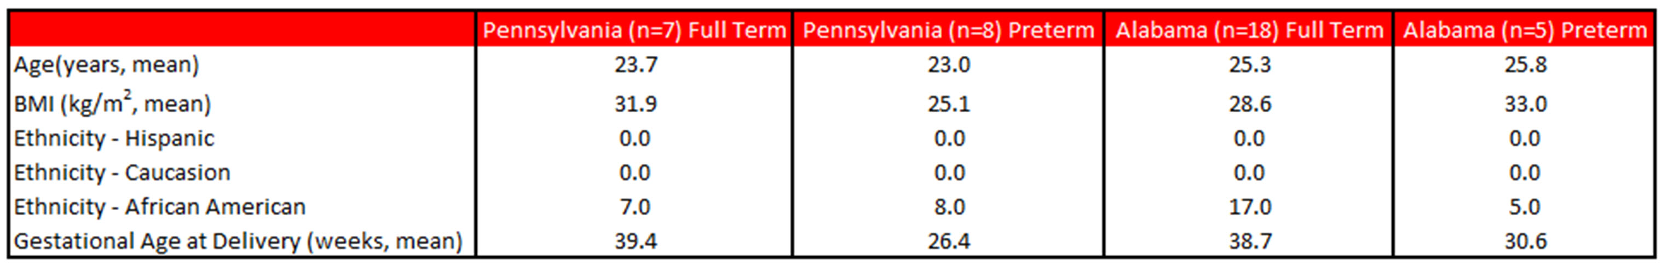
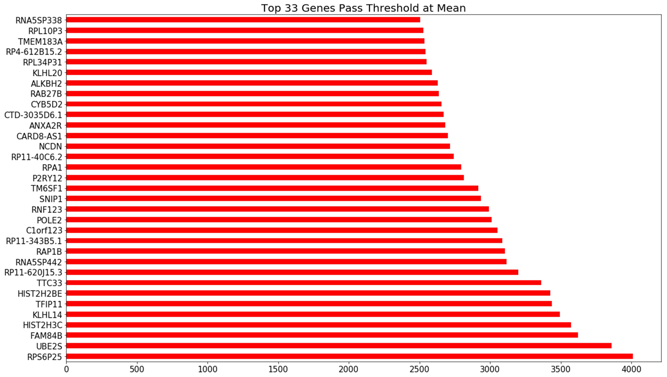
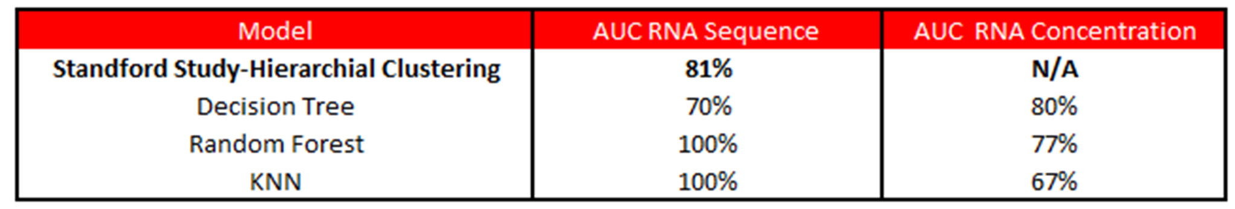
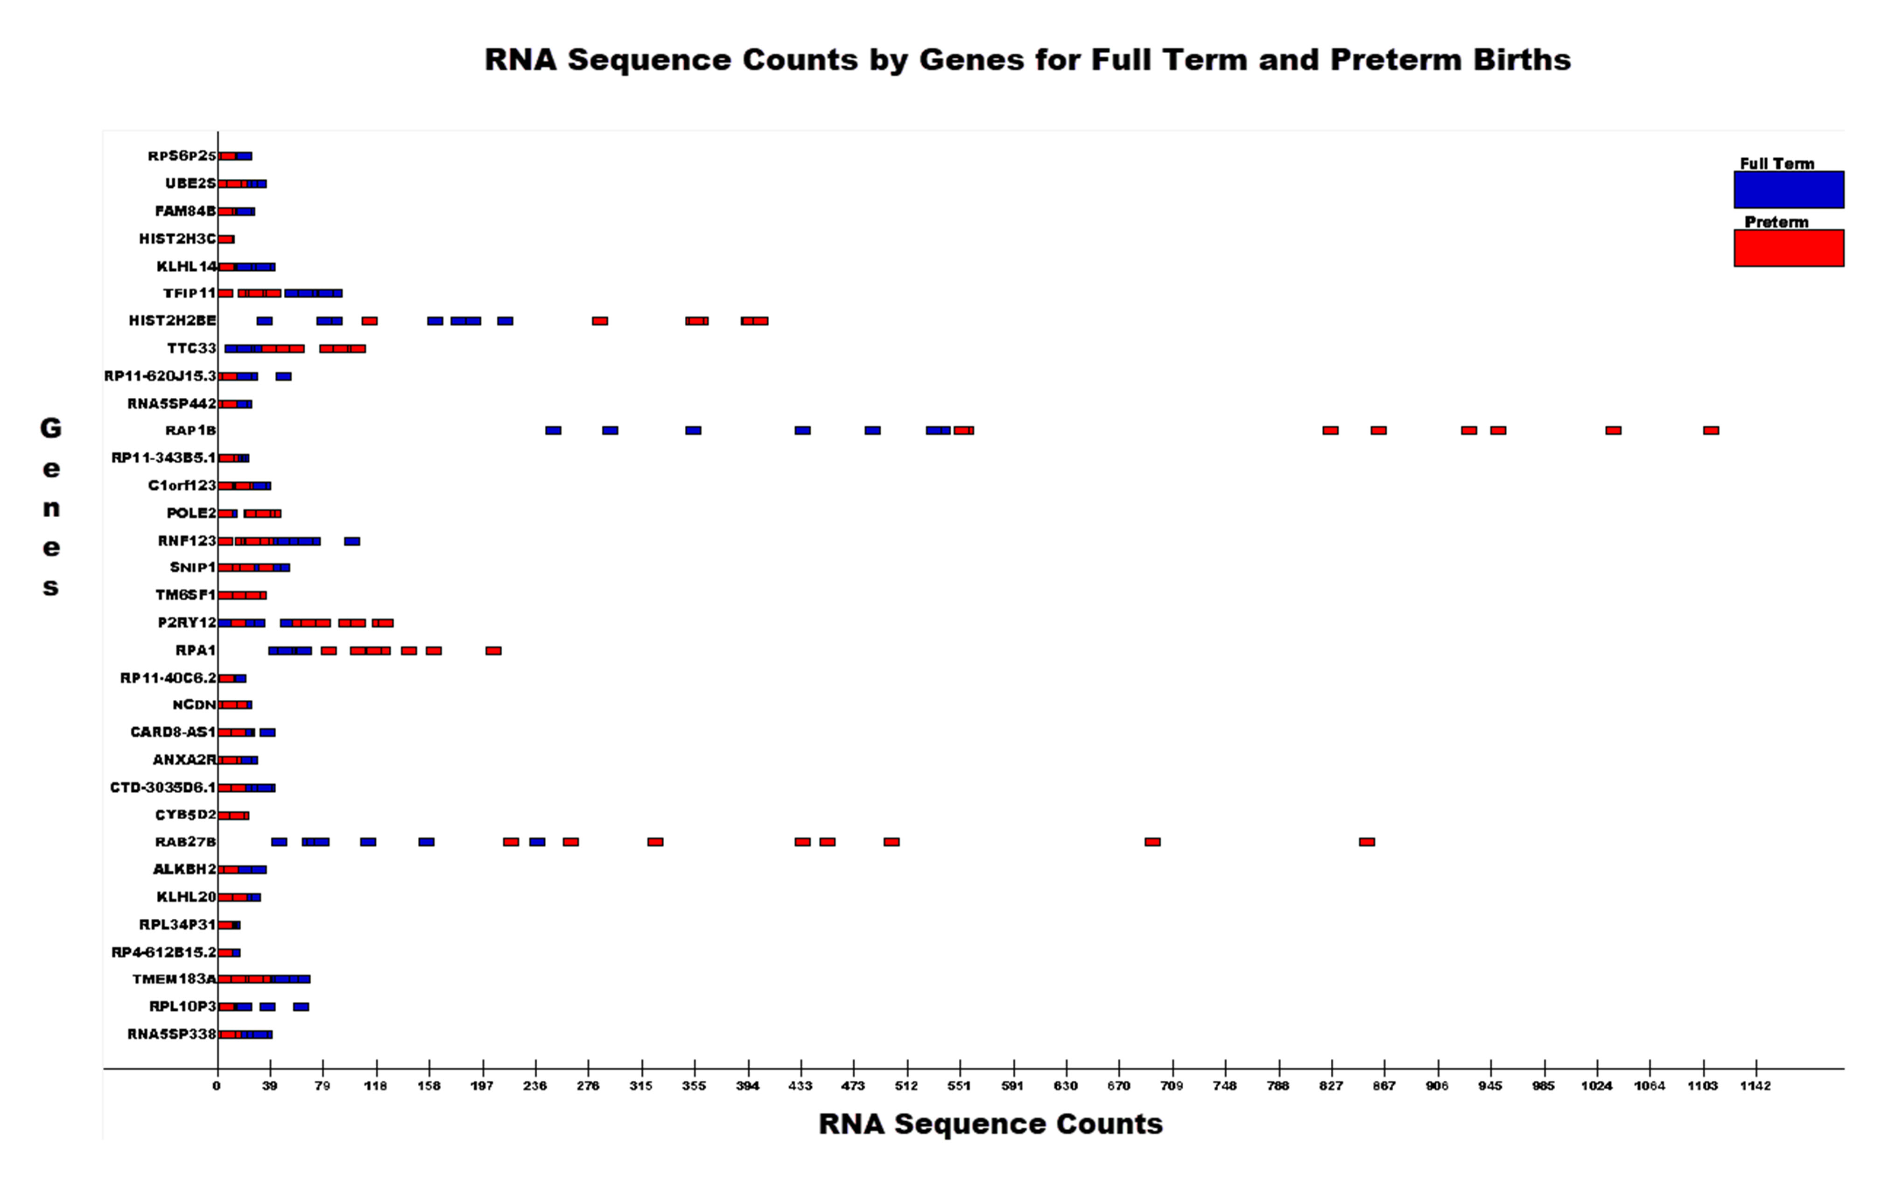

Predicting Preterm Births using cfRNA
Jason Lin, Jonathan Marin, and John Santerre PhD
Master of Science in Data Science
Southern Methodist University, Dallas, TX 75275, USA
Introduction
Model Classification
Preterm birth is the leading cause of death in infants
15 million babies are born prematurely before 37 weeks every year
Rates of preterm birth range from 5% to 18% across 184 countries.
To mitigate small sample size, stratified shuffle split was implemented
To optimize AUC, area under curve, grid search was used to determine best model
The measurement of AUC is used to compare to the Stanford Study
The following models were used:
Decision Tree
Random Forest
K-Nearest Neighbors
Problem
Modern medicine currently has no definitive indication for preterm birth
Measures can be taken to possibly prevent preterm birth if an early indication existed
Currently the health industry lacks insight in preterm birth related to gene expression
Results
Data Summary
Conclusion
Non-invasive blood samples were taken for women who delivered full term and preterm. ​
Two cohorts from University of Alabama of Birmingham and University of Pennsylvania
For each cohort blood samples contained two data sets of feature data gene expressions for:
Gene concentrations (36 women observed)
RNA sequence counts (15 women observed)
Population observed in this data set are all African American
Machine learning increased AUC to 100% compared to the Stanford Study of 81%
The RNA concentration data set containing two cohorts was not as predictive as the RNA sequence count of one cohort.
A more diverse sample should be collected to confirm results
Sources
"Preterm Birth." World Health Organization. February 19, 2018. Accessed July 08, 2019. https://www.who.int/news-room/fact-sheets/detail/preterm-birth
Digitale, Erin. "Blood Test for Pregnant Women Can Predict Premature Birth, Stanford-led Study Reports." News Center. June 7, 2018. Accessed July 08, 2019. https://med.stanford.edu/news/all-news/2018/06/blood-test-for-pregnant-women-can-predict-premature-birth.html.
Ngo, Thuy T. M., Marie-Louise H. Rasmussen Mira N. Moufarrej, Joan Camunas-Soler, Wenying Pan, Jennifer Okamoto, Norma F. Neff, Keli Liu, Ronald J. Wong, Katheryne Downes, Robert Tibshirani, Gary M. Shaw, David K. Stevenson, Joseph R. Biggio, Michal A. Elovitz, Mads Melbye, and Stephen R. Quake. "Noninvasive Blood Tests for Fetal Development Predict Gestational Age and Preterm Delivery." Science. June 08, 2018. Accessed July 08, 2019. https://science.sciencemag.org/content/360/6393/1133
Gene Selection
Extra Trees Classifier was used to reduce from ~50,000 and determine best genes for indication of preterm birth
Extra Trees Classifier was executed 100,000 times because instability in gene importance determination
Each iteration for gene selection was counted for weighting of most important genes

